Slide 1

Jubilee Year 2025
Pilgrims of Hope

Slide 2
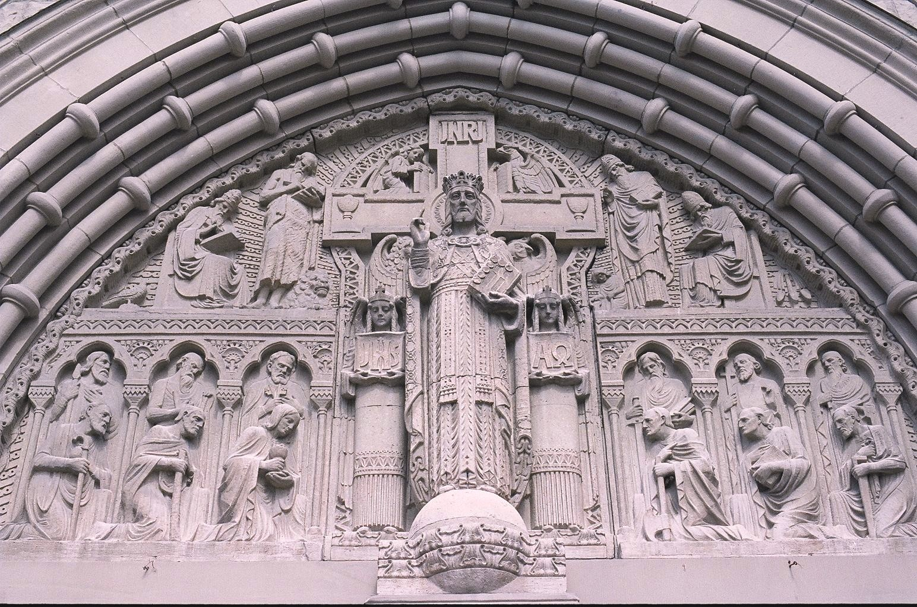
Pope Francis in his Bull of Indiction
“Spes Non Confundit”
(Hope Does Not Disappoint)
has declared 2025 a Jubilee Year
Pilgrims of Hope
December 24, 2025 – January 6, 2026
In the Diocese of Salt Lake City
Opening Mass at the Cathedral of the Madeleine
Sunday, December 29, 2024, 11:00 AM English, 3:00 PM Spanish

Slide 3
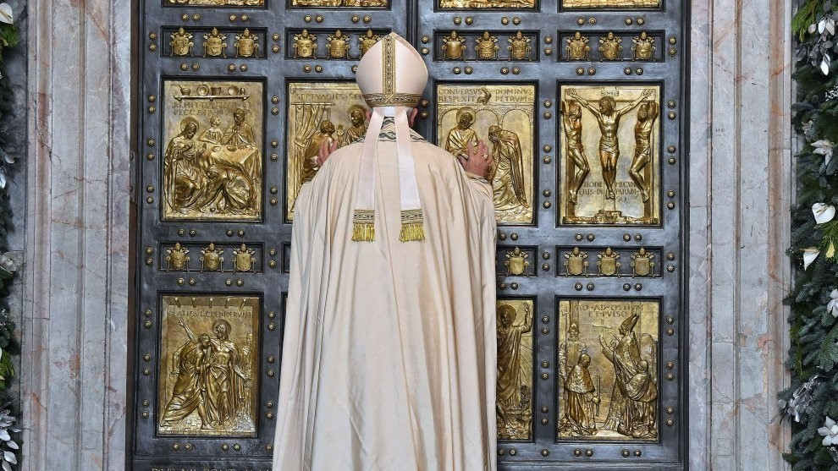
Opening Mass at the Cathedral of the Madeleine
Sunday, December 29, 2024, 11:00 AM English, 3:00 PM Spanish

Slide 4
Four stylized figures representing all of humanity coming from the four corners of the earth
They embrace each other, are in fraternity, solidarity and unity
They embrace the Cross of Hope, a sign of Faith
Over rough waves, life is not always calm
Cross anchors them, provides strength and hope
Pilgrimage is not an individual journey, but communal
Cross is not static, but dynamic, bending toward humanity

Slide 5
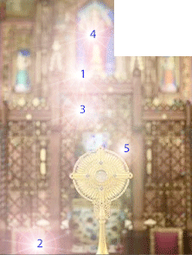
Diocesan Jubilee Pilgrimage Churches
The Cathedral of the Madelein
Salt Lake City
Saint George Catholic Church
Saint George
Saint Francis of Assisi Catholic Church
Orem
Saint Joseph Catholic Church
Ogden
Notre Dame de Lourdes Catholic Church
Price

Slide 6
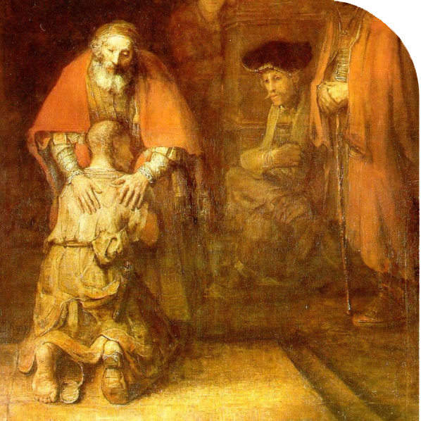
Indulgences
The Jubilee Indulgence is a concrete manifestation of God's mercy, which goes beyond and transforms the boundaries of human justice. This treasury of grace entered human history in the witness of Jesus and the saints, and by living in communion with them our hope for our own forgiveness is strengthened and becomes a certainty. The Jubilee indulgence allows us to free our hearts from the weight of sin because the reparation due for our sins is given freely and abundantly.
In practical terms, the experience of God’s mercy involves some spiritual acts indicated by the Pope. Those who cannot make the Jubilee pilgrimage due to illness or other circumstances are nonetheless invited to take part in the spiritual movement that accompanies the Jubilee year, offering up the sufferings of their daily lives, and participating in the Eucharistic celebration.
Plenary Indulgence
Sacrament of Reconciliation
Receive Communion
Pray for the Intentions of the Pope
Along with a pilgrimage, a work of mercy, or an act of penance.
Make a pilgrimage to Christ present in the prisoner, sick, hungry, naked, or welcoming a migrant.

Slide 7
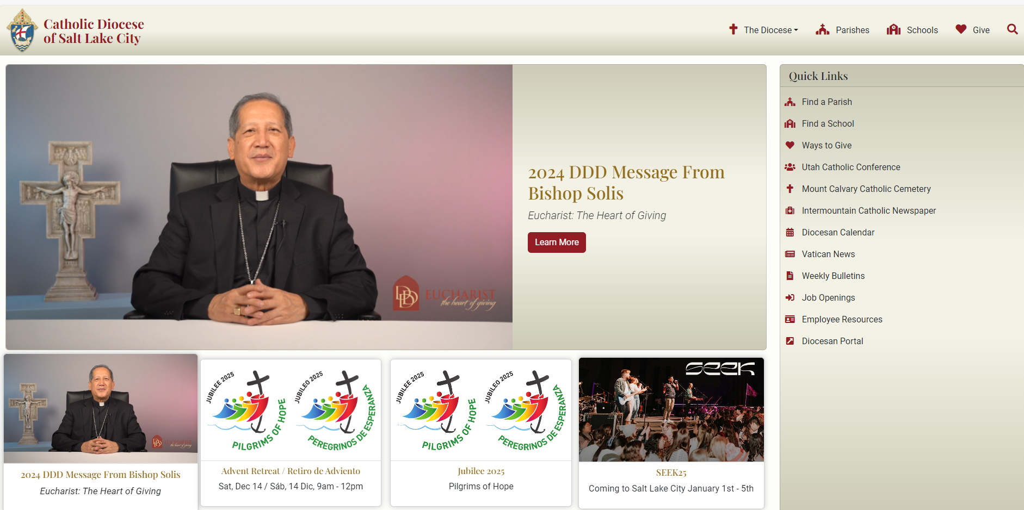
https://www.dioslc.org/jubilee-2025-pilgrims-of-hope

